Slide 1
Proposal Terms, Understanding and Laser Powder Bed Fusion
By Ayyoub Aggour

Slide 2
Format
Input (Prompt entered ChatGPT):
Term:
Output:
*Some paraphrasing was done on my part to ensure a clear descriptive answer

Slide 3
Terms
“What is Additive Manufacturing”
Additive Manufacturing
Process to create 3D objects by layering, fusing, or joining material until the object is formed in contrast to subtractive material which takes away material

Slide 4
Terms
“What is a data quality assessment”
Data Quality Assessment
Evaluating data for the accuracy, completeness, reliability, and relevance of the data to ensure it meets the required standards for its intended use

Slide 5
Terms
“What is Uncertainty Quantification”
Uncertainty Quantification
UQ involves the study and measurement of unpredictability or variability within mathematical models or simulations. It aims to understand and characterize factors that introduce variability into model predictions, assess their impact on outcomes, and develop methods to manage and mitigate these uncertainties.

Slide 6
Terms
“What is Data Integration”
Data Integration
Involves combining data from different sources to provide a unified view

Slide 7
Terms
“What is Machine Learning”
Machine Learning
A subset of AI that involves training algorithms to recognize patterns and make decisions based on the data

Slide 8
Terms
“What is a Numerical Model”
Numerical Model
A mathematical representation of a system that uses numerical methods to solve equations and simulate the behavior of the system

Slide 9
Terms
“What is verification”
Verification
Verification refers to the process of determining whether the outputs of a computational model or simulation accurately represent the intended computational model

Slide 10
Terms
“What is validation”
Validation
Validation, in the context of computational modeling and simulation, refers to the process of assessing the degree to which a model accurately represents the real-world event it is intended to simulate or predict.

Slide 11
Terms
“What is Data Quality Management”
Data Quality Management
Data Quality Management (DQM) refers to the processes and activities that organizations undertake to ensure that their data meets the required quality standards for its intended use.
Similar to a Data Quality Assessment

Slide 12
Laser Powder Bed Fusion (LPBF)
A very common form of 3D printing for metal parts. LPBF is useful because it allows intricate designs, lightweight parts, and optimized geometries to be effectively manufactured. LPBF involves using metal powders which are applied by a powder recoater and a laser that produces a melt pool. Due to this melt pool, it affects the built in microstructures which can lead to a high residual stress. These factors which impacts the parts integrity and structure can be crucial when it comes to creating parts that need precision.

Slide 13

LPBF Applications
Aerospace Industry
Automotive Industry
Medical and Dental
Jewelry and Art
Research and Development

Slide 14
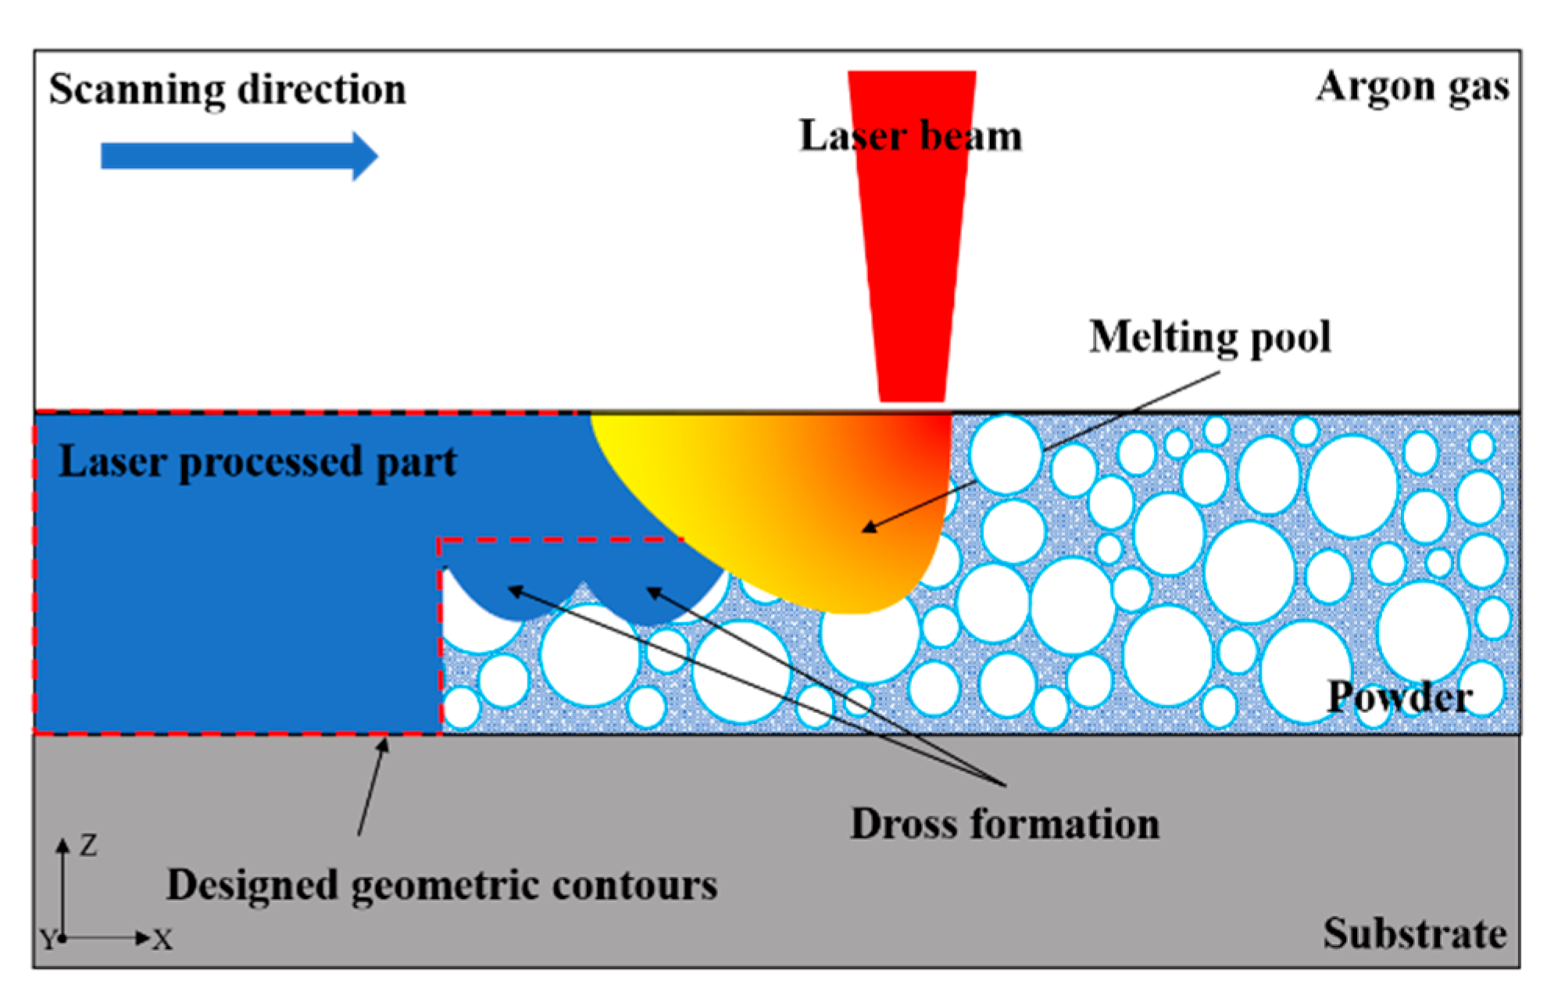
LPBF Images

Slide 15
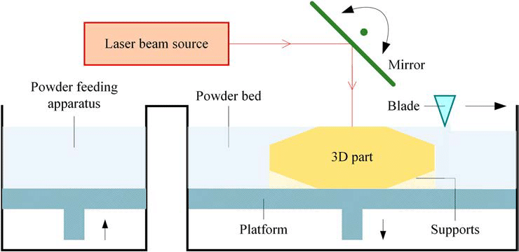
LPBF Images

Slide 16
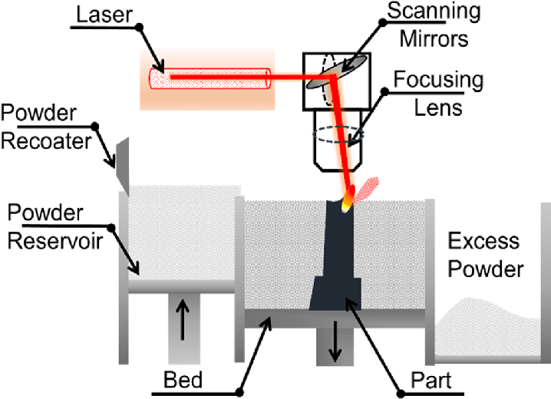
LPBF Images

Slide 17
Helpful Articles
Laser powder bed fusion: a state-of-the-art review of the technology, materials, properties & defects, and numerical modelling – ScienceDirect
Video: What Is Laser Powder Bed Fusion (LPBF)? | Additive Manufacturing

Slide 18
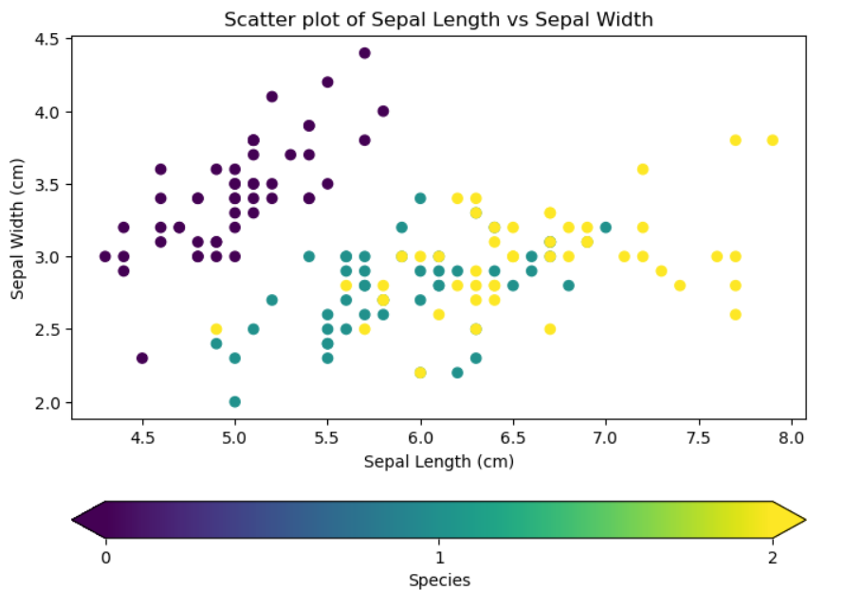
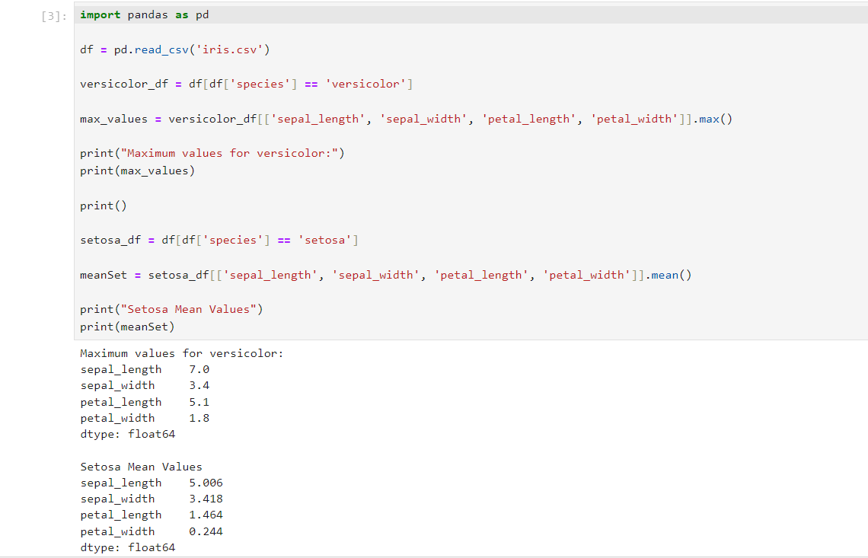
6/26
Notes: Most of the stuff done today was basic such as using the iris dataset to perform some statistical analysis and graph some of the data points

Slide 19
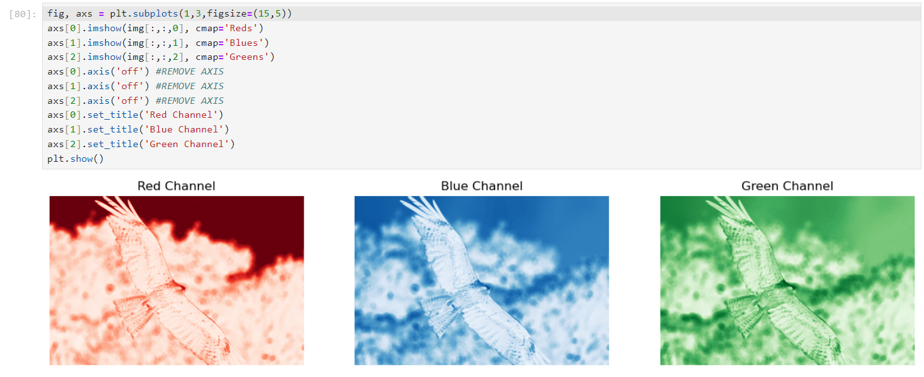
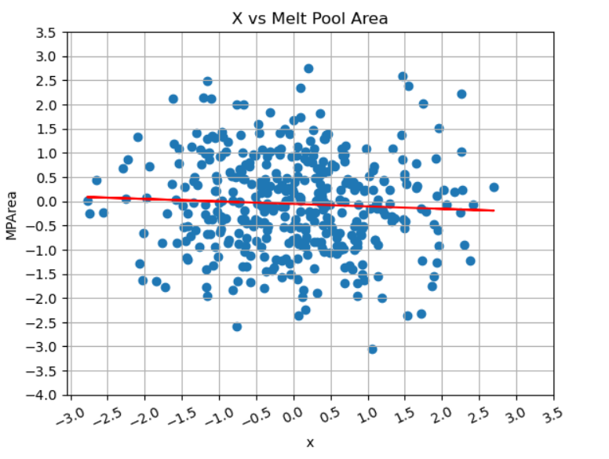
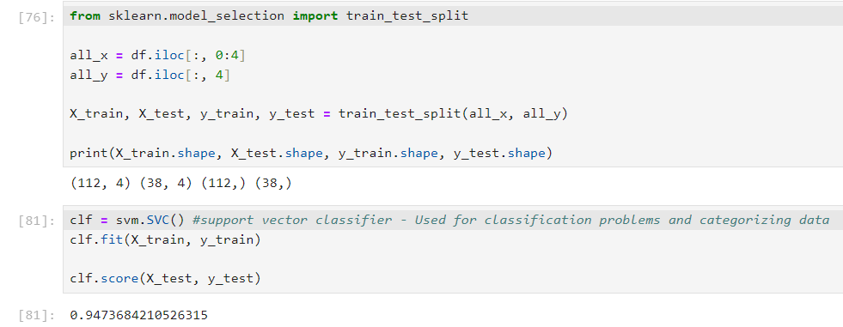
6/27
Notes: Today I did lots of work regarding OpenCV and the Train_Test_Split function. I learned about how TTS usually uses a 80 – 20% split for training data.

Slide 20
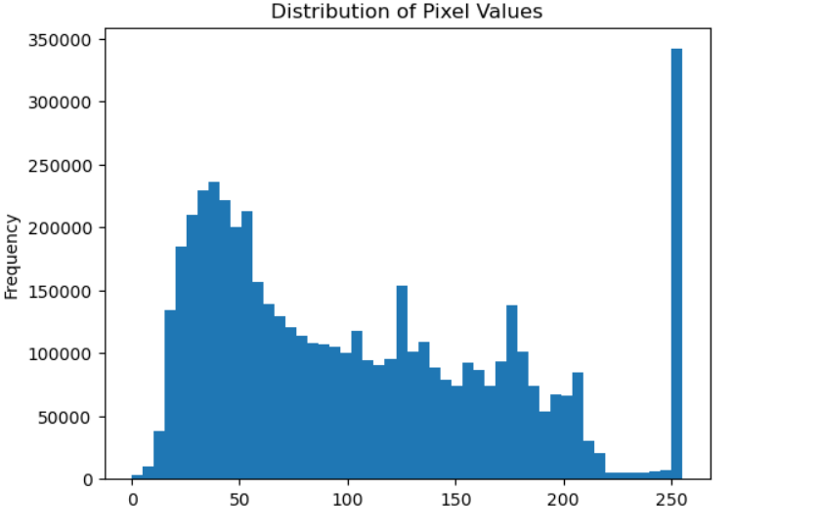
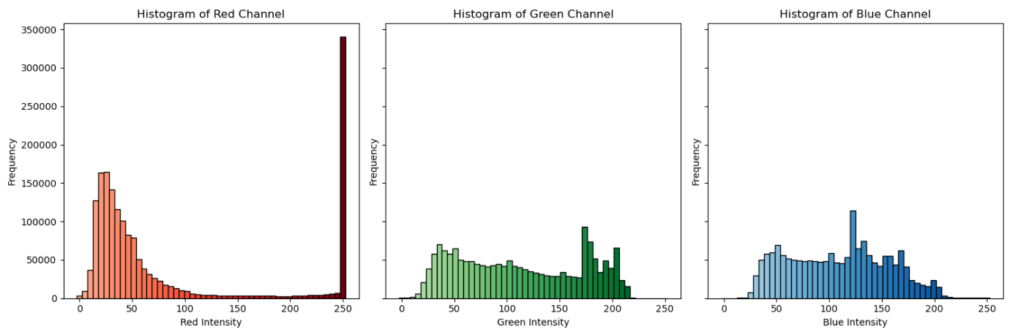
6/28
Notes: I played around with the image in OpenCV and created graphs that represent the intensity of the RGB in the image. The three graphs at the bottom contain the individual Reds, Greens, Blues with Gradients

Slide 21
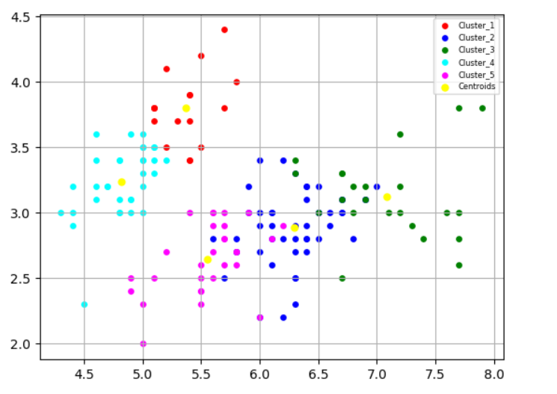
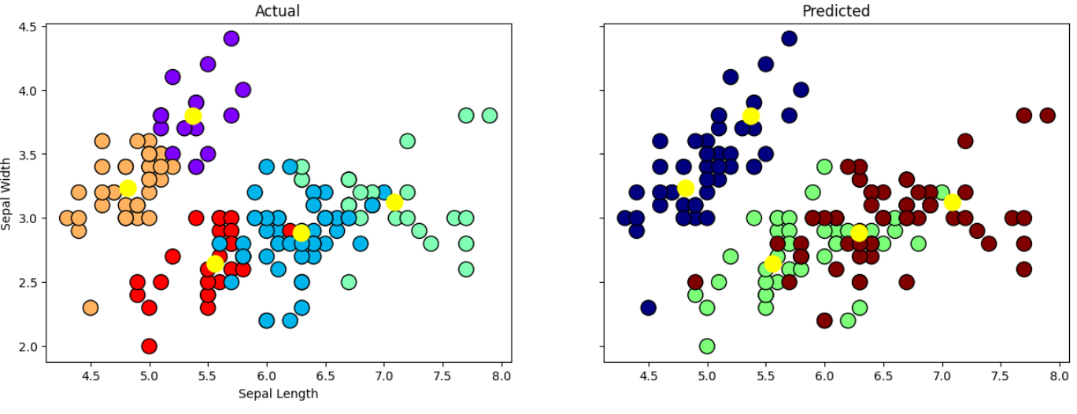
7/1
Notes: I explored clusters and centroids within datasets and used the Iris dataset to run some tests on it and get familiar with the process, functions, and outcome.

Slide 22
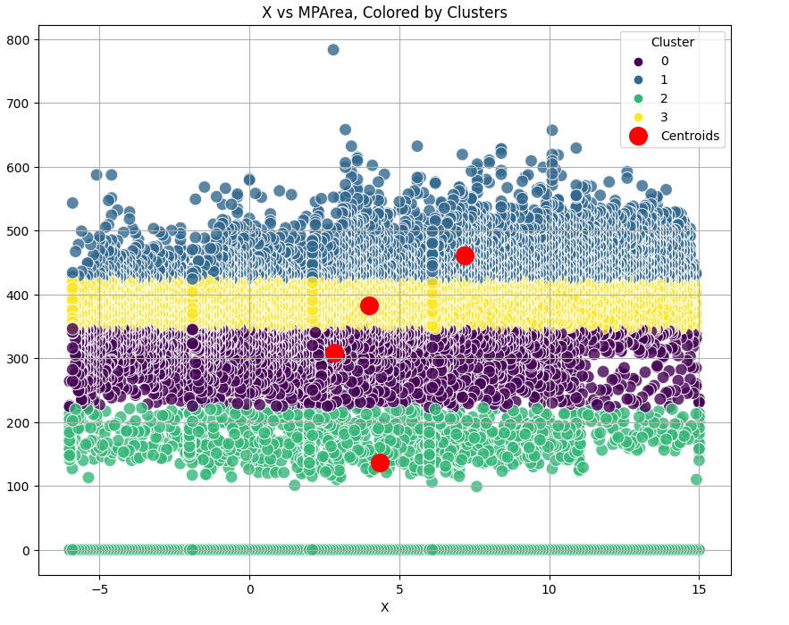
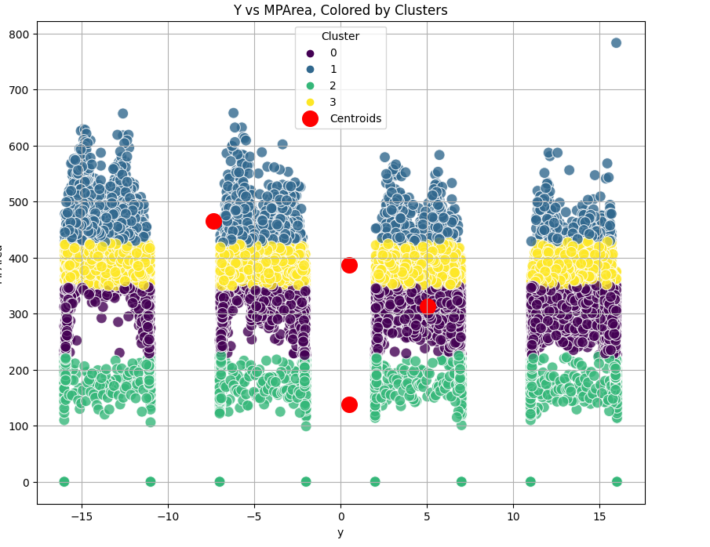
7/2
Notes: Today I spent most of my time exploring what relationships could exist within the LPBF dataset and did some clustering with the x, y and Melt Pool Area comparison.

Slide 23
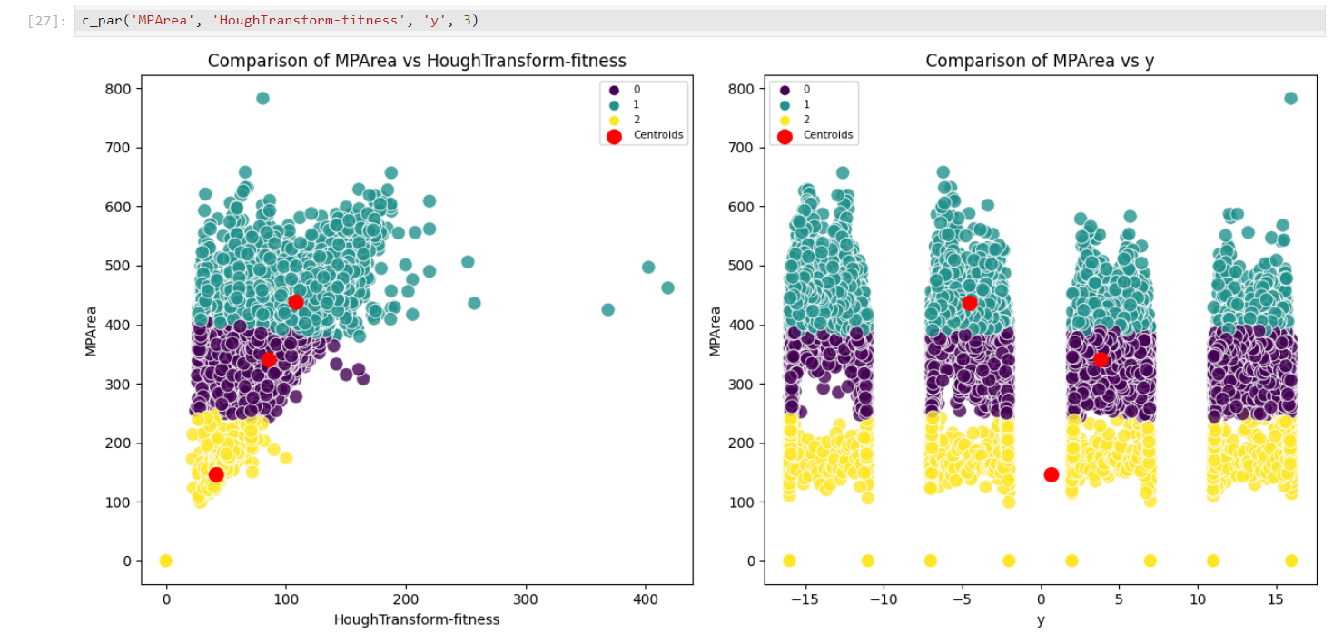
7/3
Notes: Created a function that takes in 3 parameters and graphs them against each other to make it efficient to compare instead of hard coding every time. I also allowed you to change the number of clusters you want incase it should be changed.

Slide 24
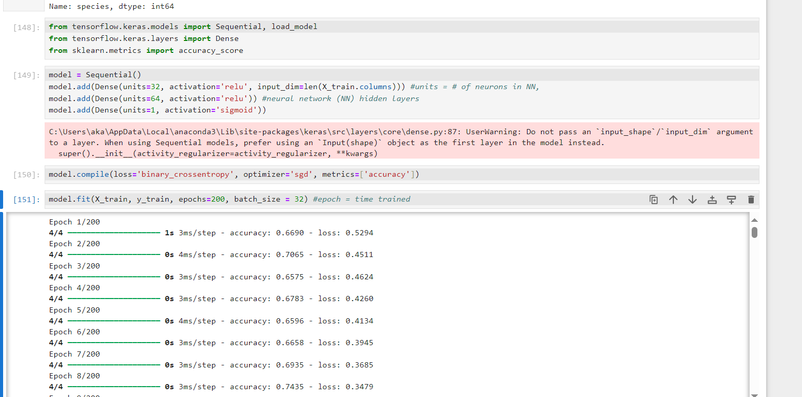
7/8
Notes: Started working with TensorFlow to start practicing and getting familiar with ML. Here I was using the Iris dataset and training it to see if it can use the variables given to identify if a flower was setosa or not.

Slide 25
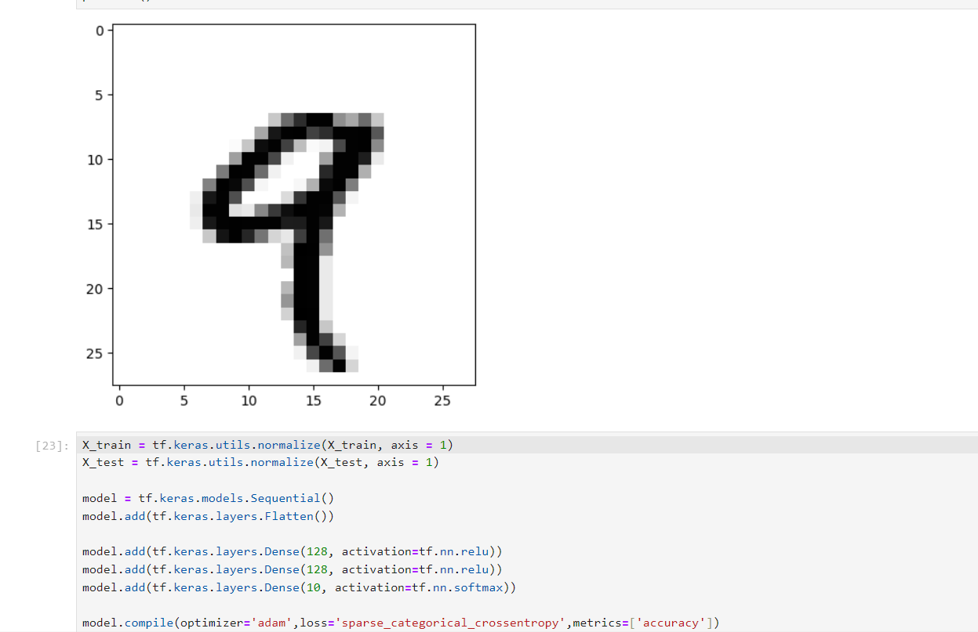
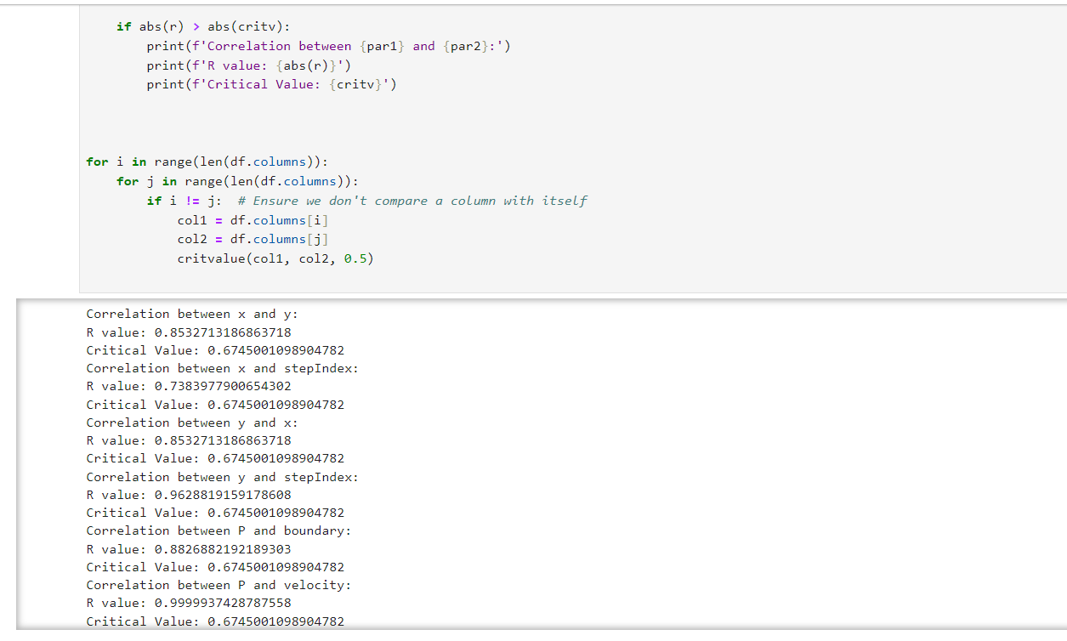
7/9
Notes: Worked with neural networks using TensorFlow trying to create a ML model that can detect what number is which from an image. I also wrapped up a small statistical projects that I started with the purpose of seeing if there was a statistically significant relationship between two variables within the dataset by calculating correlation coefficient and comparing it with the critical value.

Slide 26
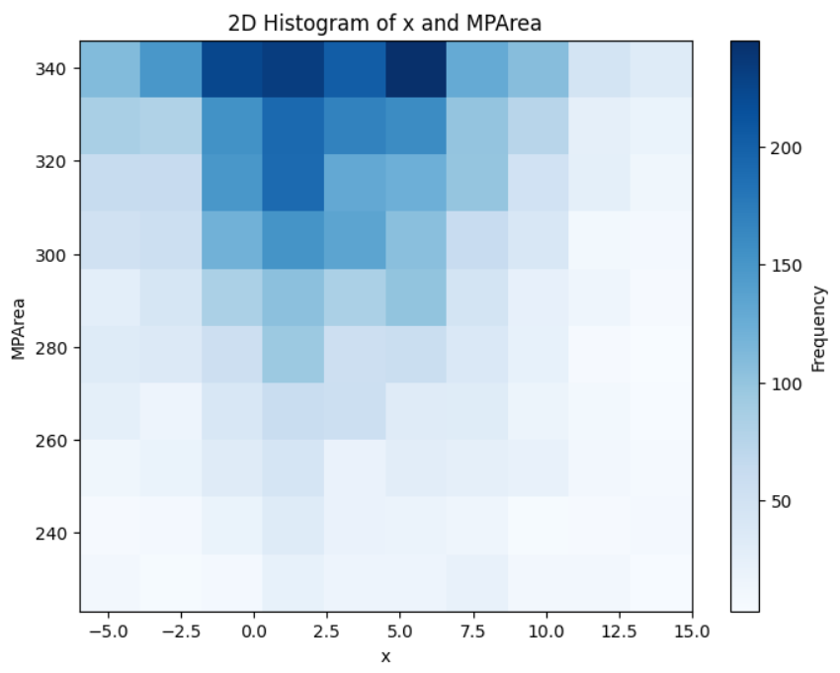
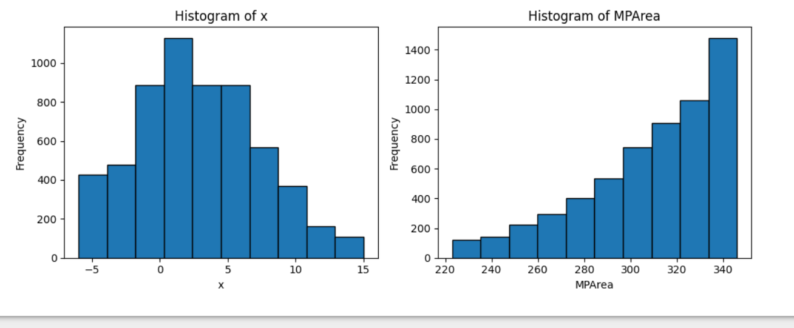
7/10
Notes: I expanded on my earlier ideas of comparing different variables to look for relationships by creating histograms of specific clusters. I created a new data frame and stored the chosen clusters data within it. I then was able to plot a sort of 3d graph that uses color intensity to describe frequency and 2 regular histograms comparing the x and y of the graph on the left and finding the frequency of each.

Slide 27
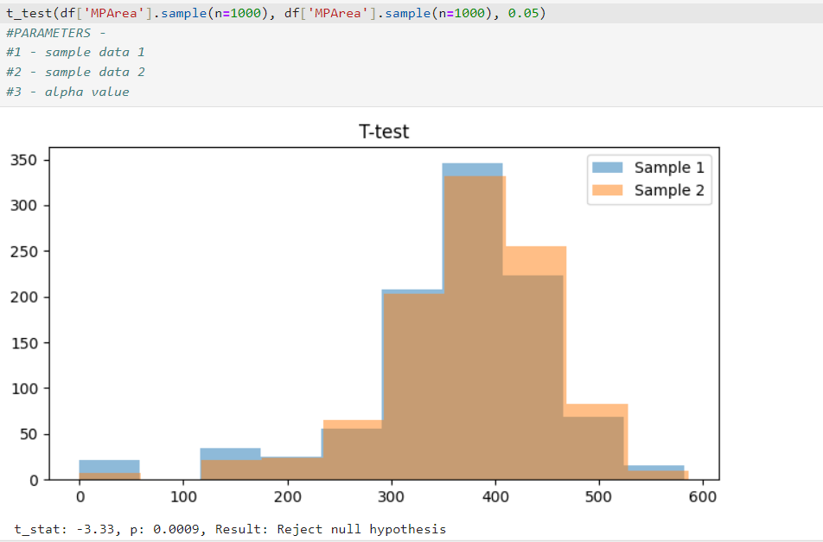
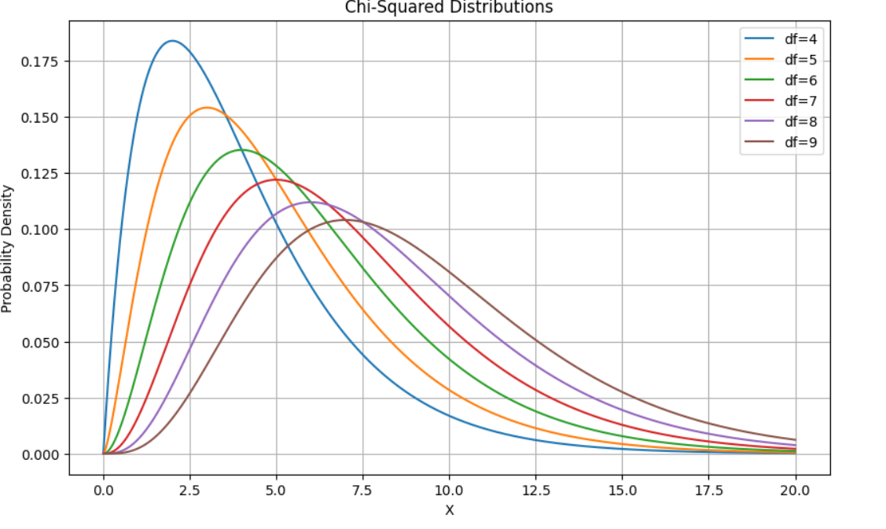
7/15
Notes: I spent most of the day starting to create functions for t-tests, Z-tests, and chi-squared-tests. I also briefly studied the statistics processes to get a better understanding of what they represented.

Slide 28
Terms - 7/16-17
Null Hypothesis (H₀): Default hypothesis/Accepted fact
Example: Class A has a higher GPA than Class B
Alternative Hypothesis (H₁): The hypothesis we want to test
Example: Class A does not have a higher GPA than class B
P-value: Describes how likely your data would have occurred by random chance if the null hypothesis were true
The smaller the p-value the more likely you are to reject the null hypothesis

Slide 29
T-test, “Hypothesis Test Statistic”
A t-test is used to compare the means of two groups. Its often used to determine whether a process or treatment influences the population or finding out if two groups differ from each other
Types of Tests:
One Sample t-test: Comparing the mean of one group against the mean of a population
Example: Taking the mean weight of 40 random turtles and using the mean to estimate the true mean of the population.
Paired Sample t-test: Compares the means of two measurements taken from the same population
Example: Trying to find out if a training program increases basketball players' jump height. Take a sample of 20 college basketball players, record their jump height and record the same player's jump height after the program.
Independent Two-Sample t-test: Analyzes the mean comparison of two independent groups
Example: Take a random sample of 40 turtles from each population and use the mean weight to determine if the mean weight is equal between populations.

Slide 30
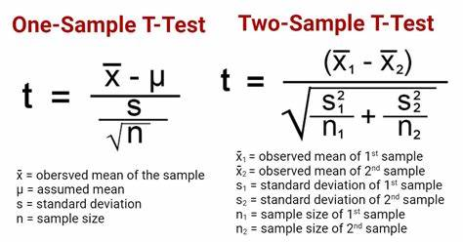
Formulas
One Sample T-test
Two Sample T-test
Paired Sample T-test
t = x_{diff} / (s_{diff}/√n)
X_{diff} = mean of the differences
S_{diff} = standard deviation of the differences
n = sample size

Slide 31
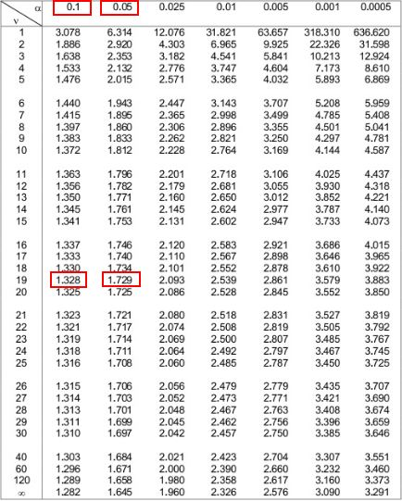
Understanding
T-value of 0 means that the sample result is exactly equal to the null hypothesis
Degrees of Freedom Formula: df = number of samples - 1
T-distributions:
These are made when you draw multiple samples of the same size from the same population and perform the same t-test. Your result would be many t-values which you could then plot, often creating a bell curve.
The peak of the graph is 0 because t-distributions assume that the null hypothesis is true
T-values become less likely as you go farther left or right on the graph, meaning that when the null hypothesis is true you are less likely to receive a sample that is very different from the null hypothesis
p-value:
To obtain the p-value use a chart that contains all the values
Example: When getting p-value, you shade the parts of the graph that are greater than the t-value and incase of a two tailed test shade above the positive/negative of the t-value. If the shaded region where to be 0.06 or 6% it would not be enough to reject the null hypothesis using the common significance level of 0.05 or 5%

Slide 32
Z-test
Like a t-test which also helps determine the significance of a set of data
One Sample Z-test:
Determine whether a population mean is different from a hypothesized value
Example: Do students in an honors program have an average IQ score different from a hypothesized value of 100?
Two Sample Z-test:
Determine whether two population means differ
Example: Do two IQ boosting programs have different mean scores?

Slide 33
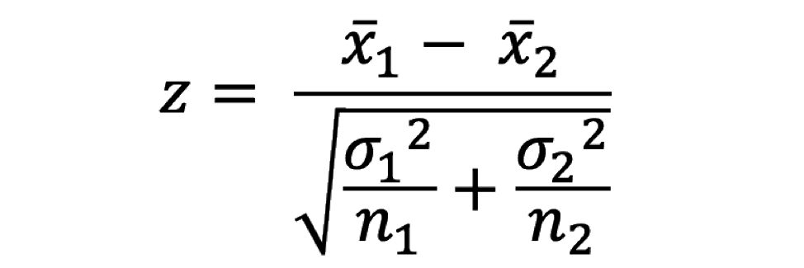
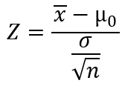
Formulas
One Sample Z-test
x = sample mean
μ₀ = hypothesized population mean
σ = population standard deviation
n = sample size
Two Sample Z-test
x₁ = sample mean in group #1
x₂ = sample mean in group #2
σ₁ = population standard deviation #1
σ₂ = population standard deviation #2
n₁ = sample size in group #1
n₂ = sample size in group #2

Slide 34
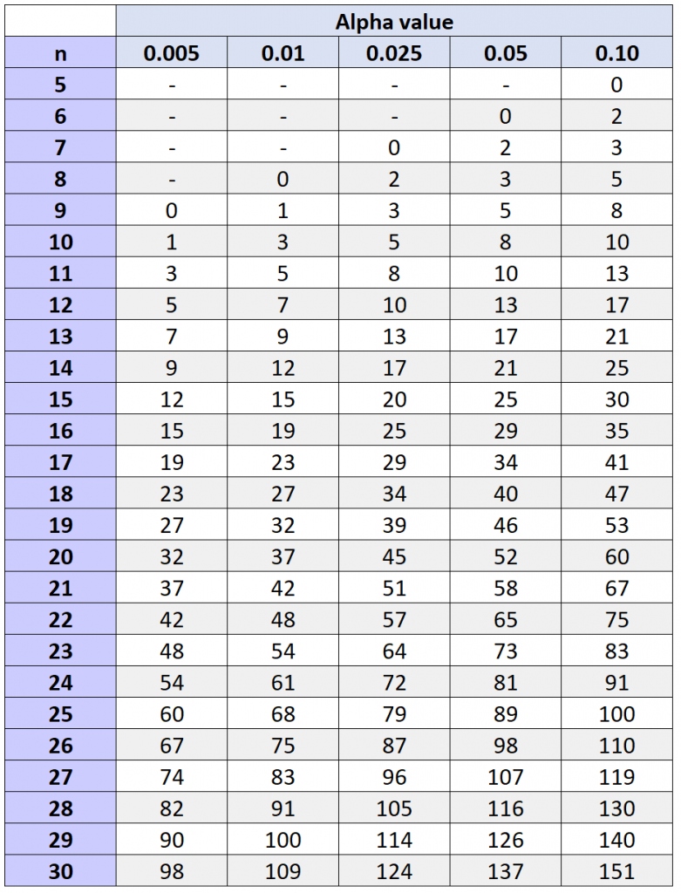
Understanding
Critical Values:
If the Z-value is outside of the critical values, then it is considered statistically significant
Example: Z-value = 1.68, Critical values = ±1.51 it IS considered statistically significant
Example: Z-value = -1.42, Critical values = ±1.51 it is NOT considered statistically significant
To get the critical values you get the tails (left tail, right tail, or two tailed) and the significance level and check the values on a table

Slide 35
Chi-Squared-test
Chi-Square Goodness of Fit Test
Determine whether a categorical variable follows a hypothesized distribution
Example: A shop owner wants to know if an equal number of people come into the shop every day and takes note of everyone who comes. The test is used to determine if the distribution of customers follows the theoretical distribution that the same number of people come in each day.
The Chi-Square Test of Independence
Determine whether there is a significant association between two categorical variables
Example: Someone wants to see if a political party is associated with gender and surveys 500 voters in the town. The test is used to determine if there is a statistically significant relationship between the two variables.

Slide 36
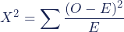
Formulas
Χ² = Chi-square test statistic
Σ = Summation
O = Observed frequency
E = Expected frequency
*Both are calculated using the same formula

Slide 37
Understanding
Chi-Square Goodness of Fit Test
Critical Value:
df = number of groups - 1
Take the significance level and compare the df and significance level on a table to get the critical value
Expected Values Calculation
Expected Count = Expected percentage * Total count
Example: Customers in the store
Total = 250
20% of customers each day (M-F)
Result: 0.2 * 250 = 50
The Chi-Square Test of Independence
Critical Value:
df = (number of variable #1 groups − 1) * (number of variable #2 groups − 1)
Take the significance level and compare the df and significance level on a table to get the critical value
Expected Values Calculation
Expected Count = (row sum * column sum) / table sum
Example: Male Republicans
Males = 250
Republicans = 230
Total = 500
Result: (230 * 250) / 500 = 115

Slide 38
Covariance Test - 7/29
Measures the extent to which 2 variables vary linearly. The formula shows whether two variables move in the same or opposite direction
Covariance is like variance in which it measures the variability around its mean except covariance assess the co-variability of two variables around their respective means
Understanding:
A high value suggests an association exists between the two, covariance shouldn't be used to test the strength of relationships but to test if they exist
A positive value means they tend to move in the same direction, Higher value 1 = Higher value 2
Example: More hours studying = Higher grades
A negative value means they tend to move in opposite directions, Higher value 1 = Lower value 2
Example: More rain = Less time spent outside

Slide 39
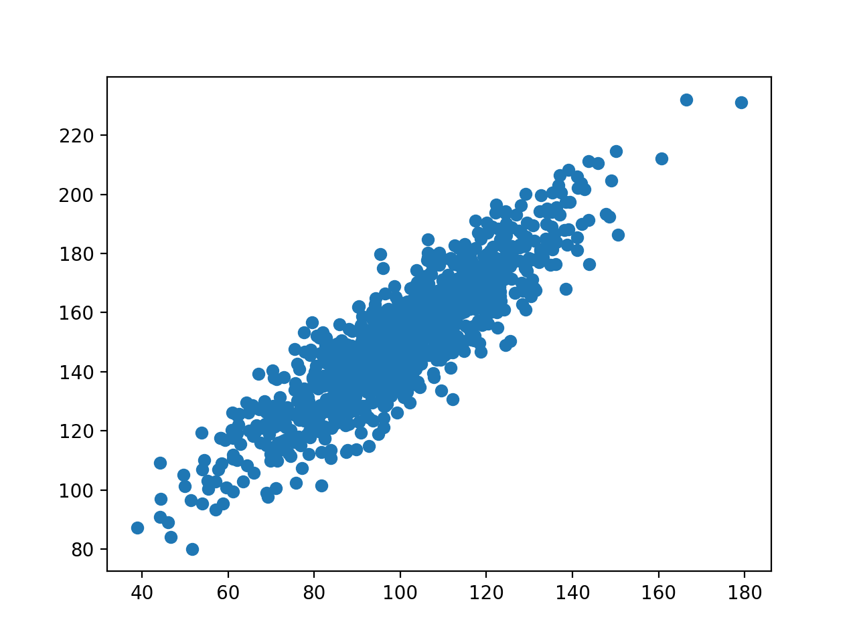
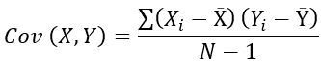
Formula
Xᵢ = observed values of X
Yᵢ = observed values of Y
X̄ = X mean
Ȳ = Y mean
N = number of observations
Positive Strong Covariance

Slide 40
Categories
Inputs:
X
Y
Power
Trigger
Results:
SKImagex0
SkImagey0
SKImageA
SKImageB
SKImageAngle
HoughTransformA
HoughTransformB

Slide 41
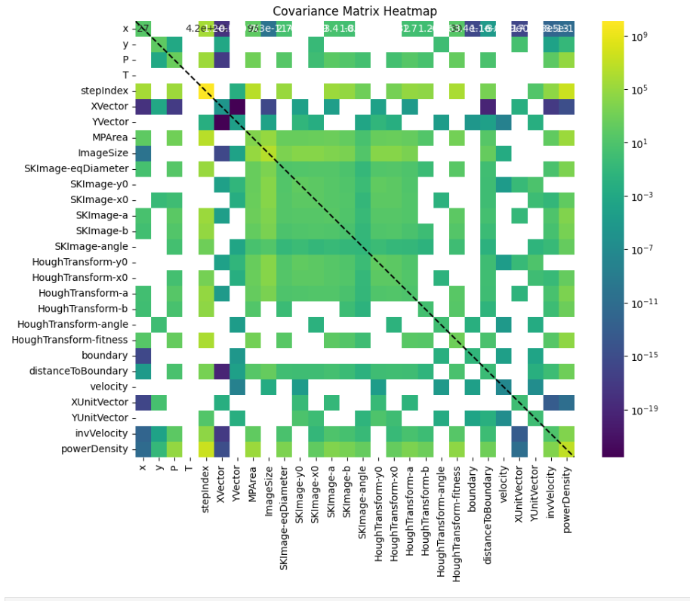
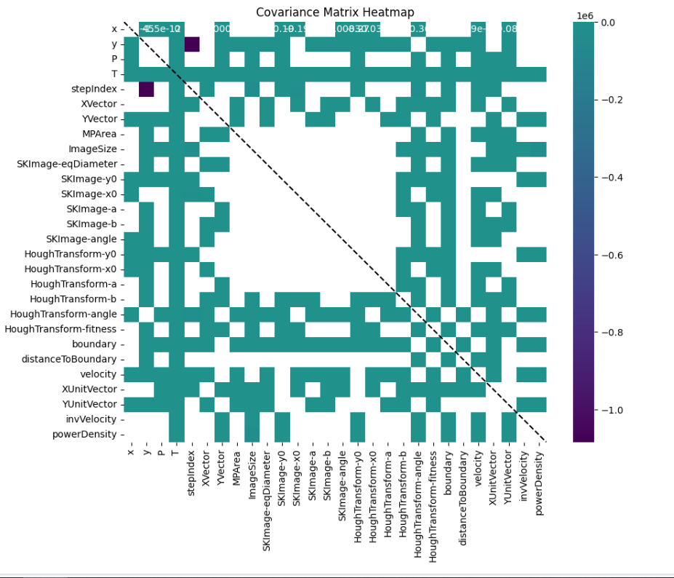
Heatmap
Left: Positive Covariance Heatmap
Right: Negative Covariance Heatmap

Slide 42
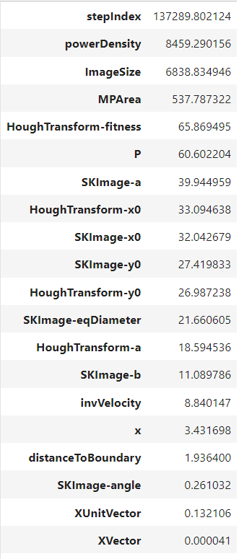
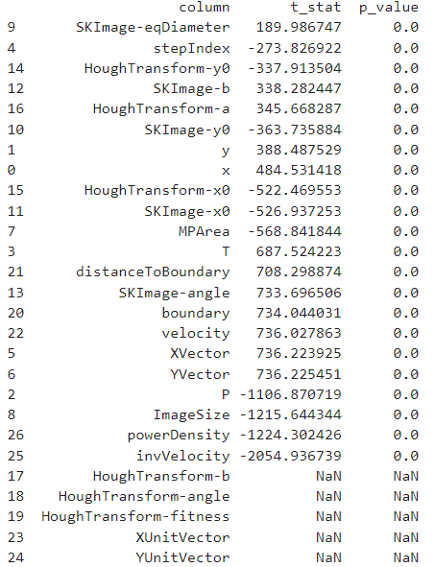
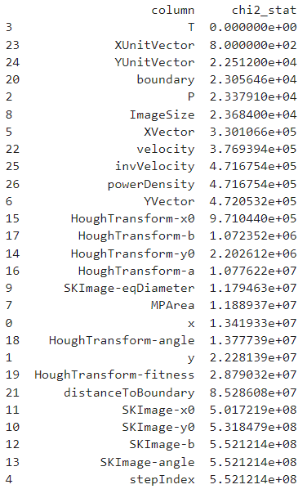
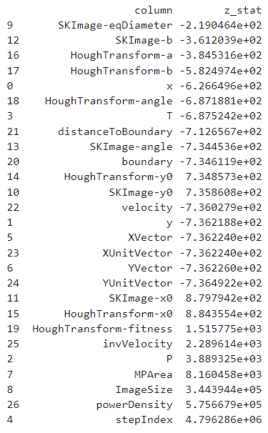
All Statistical Tests and Rankings - SKImageA
Covariance:
T-test (Smaller Values = Similar groups):
Z-test: (Smaller values = Similar Groups)
Chi-squared-test (Smaller Values = Similar groups):

Slide 43
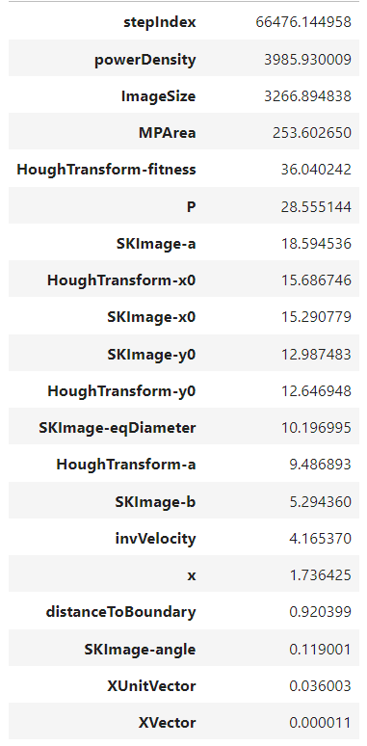
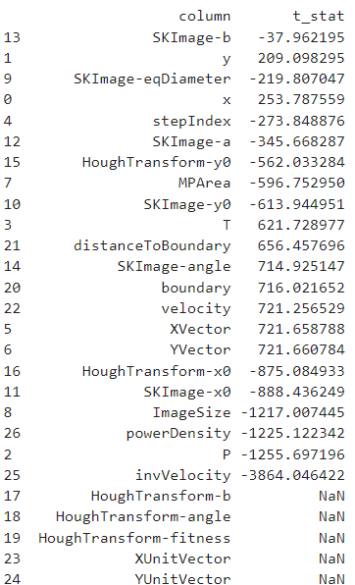
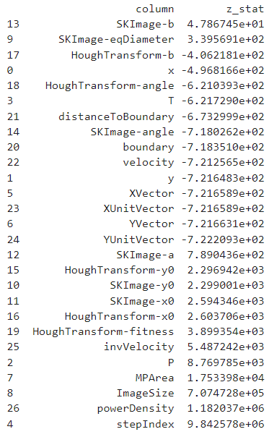
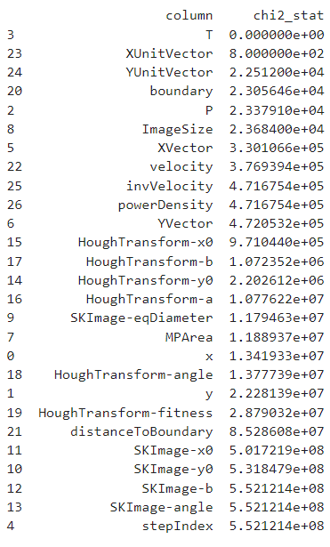
All Statistical Tests and Rankings - HoughTransformA
T-test (Smaller Values = Similar groups):
Z-test (Smaller Values = Similar groups):
Chi-squared-test (Smaller Values = Similar groups):
Covariance:

Slide 44
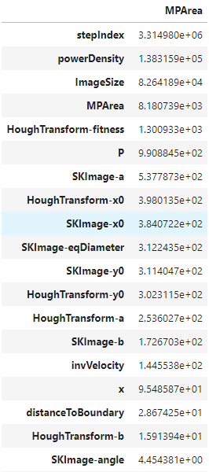
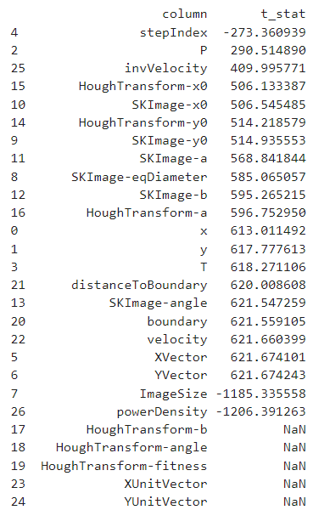
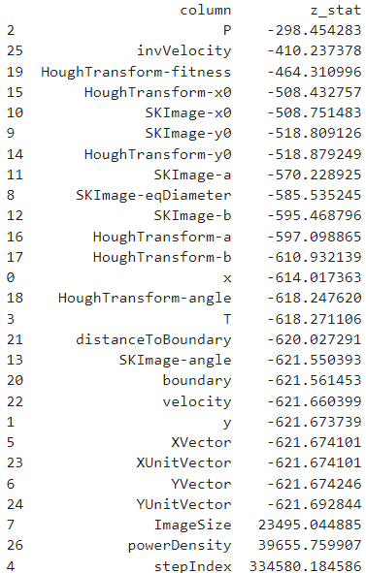
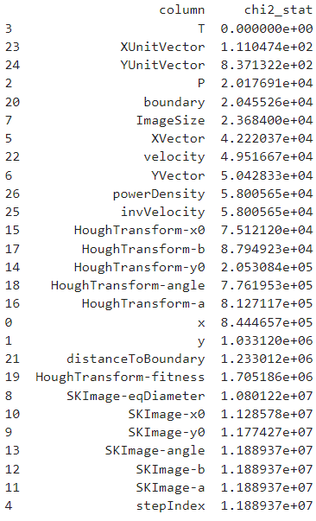
All Statistical Tests and Rankings – MP Area
Covariance:
T-test (Smaller Values = Similar groups):
Z-test (Smaller Values = Similar groups):
Chi-squared-test (Smaller Values = Similar groups):

Slide 45
Developing a ML Model
Define the problem
Collect Data
Choose Model
Train Model
Evaluate Model

Slide 46
Defining the problem
Objective: Understand and define what you want to your model to achieve
Constraints: Understand what constraints may be held in place
Success: Define how you will measure the success of the model

Slide 47
Choosing the Model
Algorithm Choice: Decide what ML algorithm should be used based on the problem type
Data: Decide the model based on data size, outliers, distribution, relationships, and inputs/outputs

Slide 48
Training the Model
Training: Fit the model to the data
Parameters: Adjust parameters to improve performance
Validation: Evaluate the model after training to prevent overfitting

Slide 49
Evaluate the Model
Metrics: Use appropriate metrics to evaluate model performance
Comparison: Compare different models or versions to determine the best one
Analysis: Analyze any errors to find any weaknesses and find ways to improve the model

Slide 50
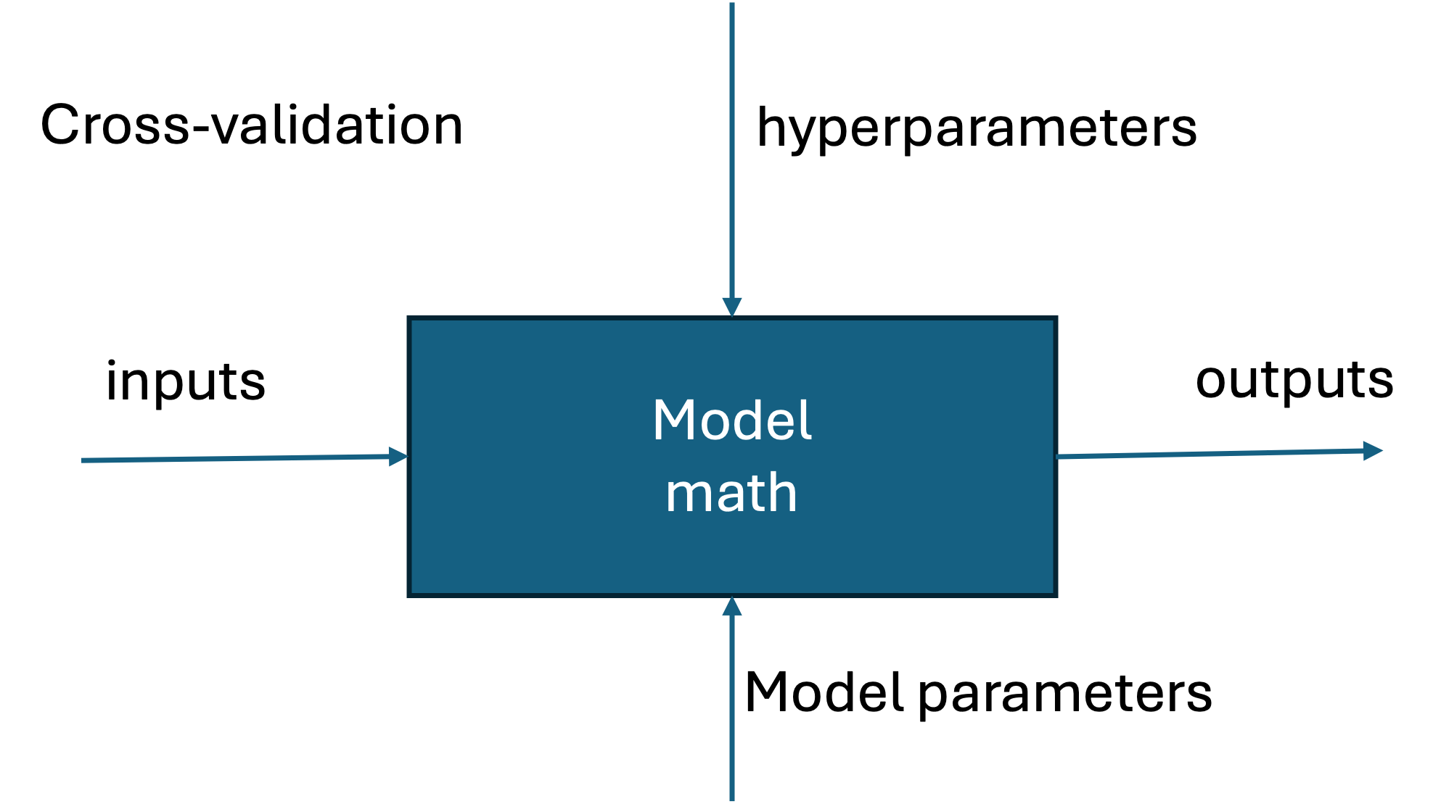
Table - RFR
Combination of Inputs | Explain why we use these variables | Results | Error Metrics
5 paras, explain why we used these 5 variables |  |  | RMSE, MAE, MSE, R2, MedAE, EVS, MaxE
 |  |  | (print values in table)

Slide 51
Coefficient of Determination (R^2)

Slide 52
What problem are we solving?

Slide 53
Goal

